Slide 1
Chapter 2
Diode Fundamentals
Prof. Francis Kofi Ampong
Senior Lecturer
Dept. of Physics, University of Science & Technology, Kumasi

Slide 2
Outline
Introduction
The Ideal Diode
The real diode
Diode Analyses (the diode models)
Special Types of p–n Junction Semiconductor Diodes
Applications of Diode

Slide 3
INTRODUCTION
The origin of a wide range of electronic devices being used can be traced back to a simple device, the p–n junction diode.
The p–n junction diode is formed when a p-type semiconductor impurity is doped on one side and an n-type impurity is doped on the other side of a single crystal.
All the macro effects of electronic devices, i.e., wave shaping, amplifying or regenerative effects, are based on the events occurring at the junction of the p–n device.
Most modern devices are a modification or amalgamation of p–n devices in various forms.
Prior to the era of semiconductor diodes, vacuum tubes were being extensively used. These were bulky, costly and took more time to start conducting because of the thermo-ionic emission.
The semiconductor diodes and the allied junction devices solved all these problems.

Slide 4
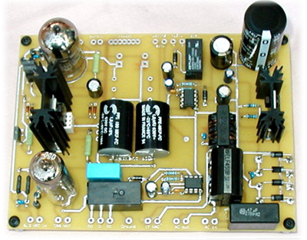
diode bridge
Notes:
Electronics Overview
Lecture 8

Slide 5
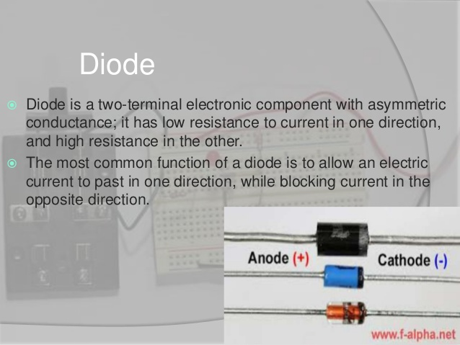

Slide 6
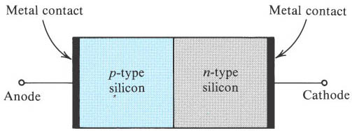
Physical Structure
The most important region, which is called pn junction, is the boundary between n-type and p-type semiconductor.

Slide 7
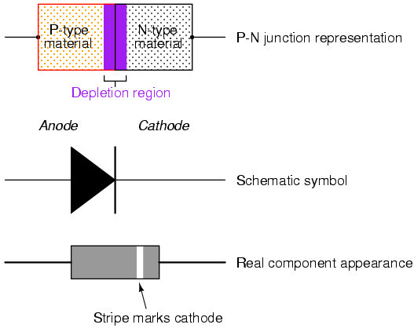
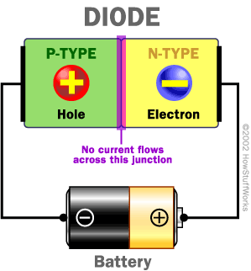
The Diode

Slide 8
Characteristics
Conducting in one direction and not in the other is the I-V characteristic of the diode.
The arrowlike circuit symbol shows the direction of conducting current.
Forward biasing voltage makes it turn on.
Reverse biasing voltage makes it turn off.
SJTU Zhou Lingling

Slide 9
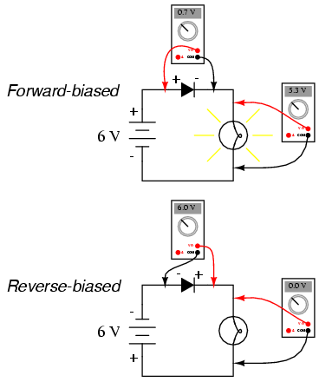

Slide 10
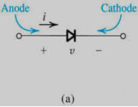
THE IDEAL DIODE
In order to understand the essence of diode function (diode behavior), we begin with a ‘’fictitious ‘’ element, the ideal diode. The ideal diode may be considered the most fundamental non-linear element. It is a two-terminal device having the circuit symbol

Slide 11
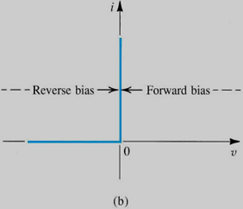
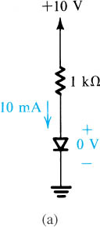

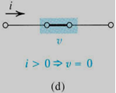
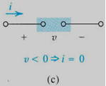
3.1 The ideal Diode
Current-Voltage characteristic
(a) diode circuit symbol
(b) i–v characteristic;
Figure 3.2 The two modes of operation of ideal diodes and the use of an external circuit to limit the forward current (a) and the reverse voltage (b).
(d) equivalent circuit
in the forward direction.
(c) equivalent circuit
in the reverse direction;
Notes:
sedr42021_0301a.jpg

Slide 12

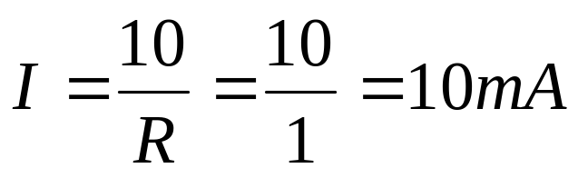
Assume both diodes are ideal
R = 1 kΩ
R = 1 kΩ
I
I
+
+
10 V
-
V_{D}
5 V
-
V_{D}
diode is turned ON
diode is turned of
Writing a loop equation yields:
Writing a loop equation yields:
V_{D} = 5 V

Slide 13
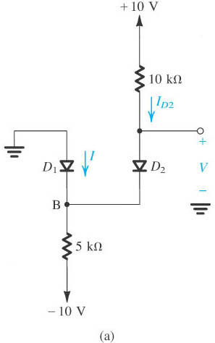

Slide 14
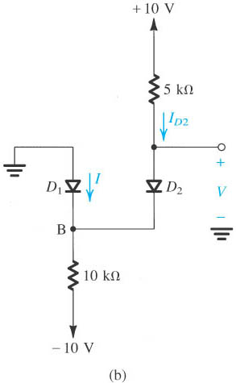

Slide 15

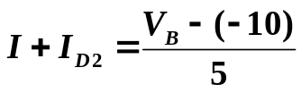


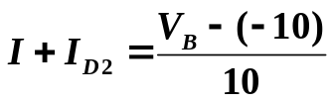




EXAMPLE 2
Assume the diodes in figure a and b are ideal. Find I and V.
Sol)
We don’t know whether none, one, or both diodes are conducting.
Make a plausible assumption, proceed with the analysis, and then check whether we end up with a consistent solution !
(a) Assume that both diodes are conducting.
V_{B} = 0, V = 0
Writing a node equation at B,
(b) Assume that both diodes are conducting.
V_{B} = 0, V = 0
Writing a node equation at B,
Impossible !!
Assume that D₁ is off, and D₂ is on.
Notes:
sedr42021_0305a.jpg

Slide 16
THE REAL DIODE

Slide 17
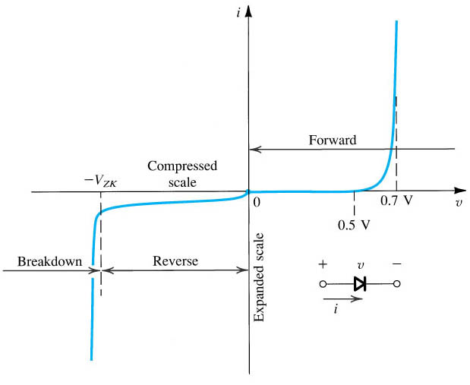
I-V Characteristics
The diode i–v relationship with some scales expanded and others compressed in order to reveal details

Slide 18



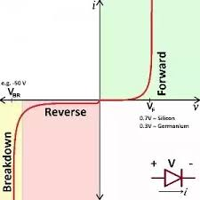
I-V Characteristic Curve
Terminal Characteristic of Junction Diodes
The Forward-Bias Region, determined by
The Reverse-Bias Region, determined by
The Breakdown Region, determined by

Slide 19
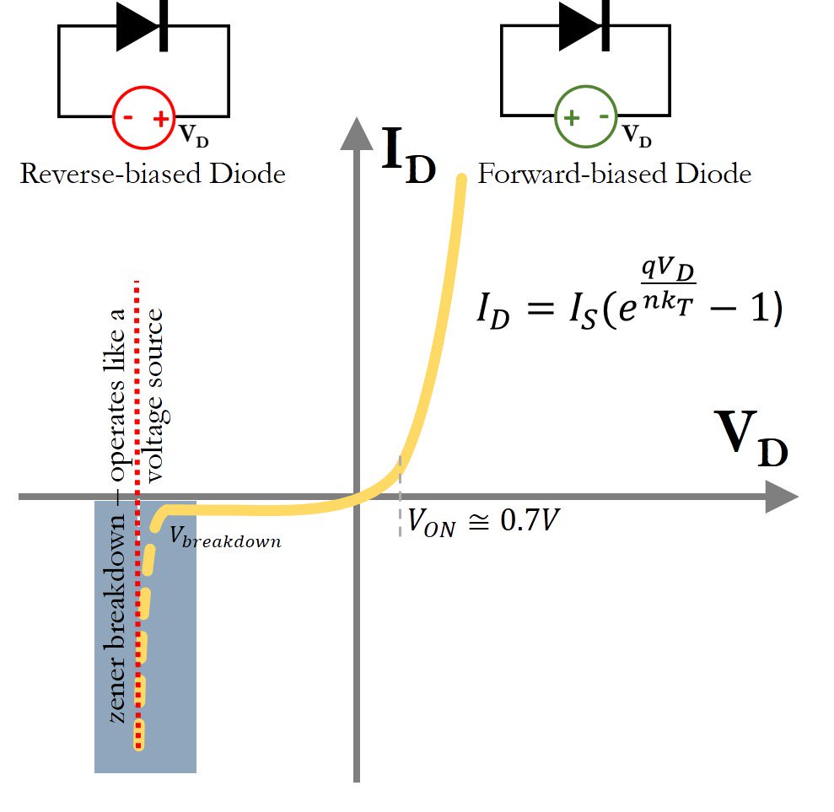
The pn Junction Under Forward-Bias Conditions
Shockley diode equation

Slide 20
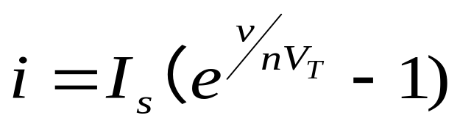


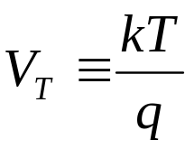
The pn Junction Under Forward-Bias Conditions
I-V characteristic equation:
  Exponential relationship, nonlinear.
  I_{s} is called saturation current, strongly depends on temperature.
  or 2， in general
  V_{T} is thermal voltage.
where k is the Boltzmann constant, T is the absolute temperature of the p–n junction, and q is the magnitude of charge of an electron (the elementary charge)

Slide 21
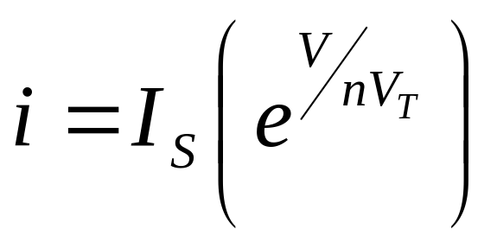
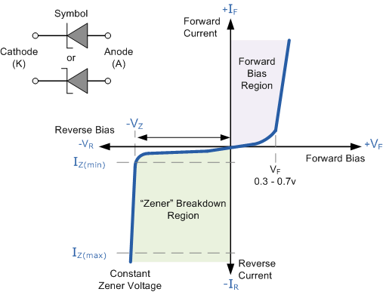
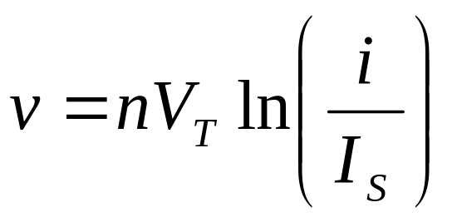
For appreciable current in the forward direction, (i>>I_{s})
This relationship can be expressed
alternatively in the logarithmic form

Slide 22
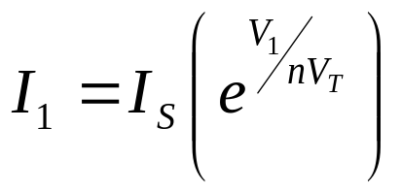
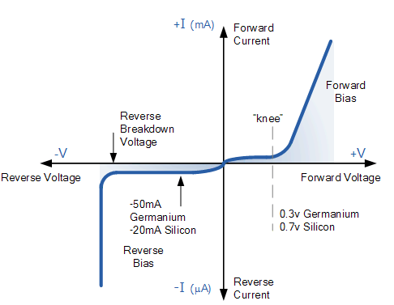
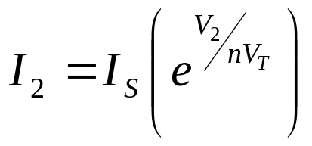
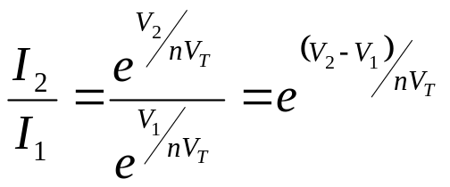
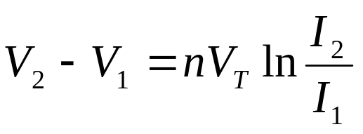
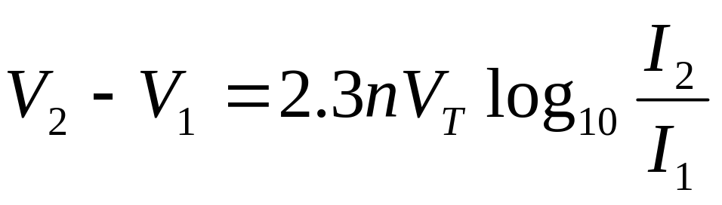
Assuming V₁ at I₁ and V₂ at I₂ then:
V₂
V₁
I₁
I₂

Slide 23
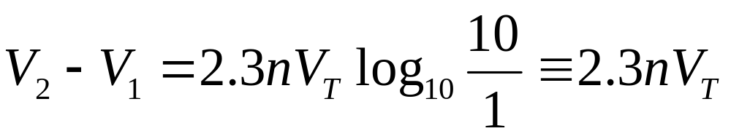
The pn Junction Under Forward-Bias Conditions
Let I₁ = 1 mA, and I₂ = 10 mA
Thus, for a decade (factor of 10) change in current, the diode voltage drop changes by 2.3nV_{T} which is approximately 60mv (for n=1) or 120mv (for n=2).

Slide 24
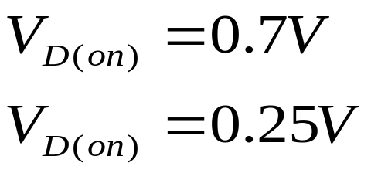
The pn Junction Under Forward-Bias Conditions
Turn-on voltage
A conduction diode has approximately a constant voltage drop across it. It’s called turn-on voltage.
Diodes with different current rating will exhibit the turn-on
voltage at different currents.
For silicon
For germanium

Slide 25
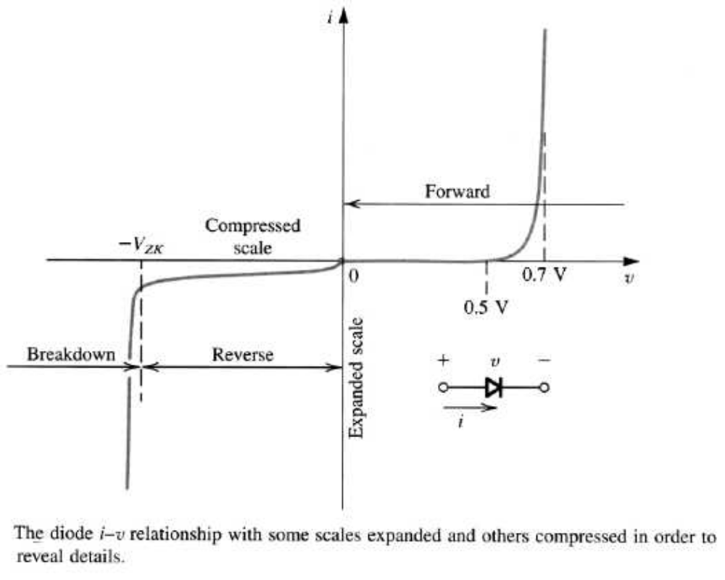
The experimental I-V characteristic of a Si diode

Slide 26
Diode Analyses: The Diode Models
Circuit Model
  Piece wise linear model
  The constant-voltage-drop model
  Iterative analysis

Slide 27
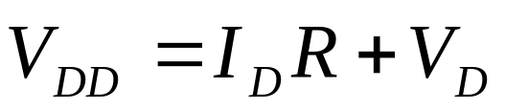
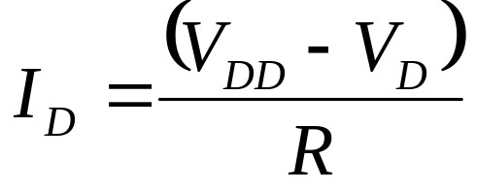
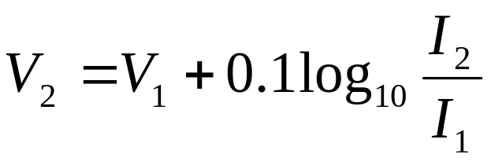
Example
Determine the current I_{D} and the diode voltage V_{D} for the circuit in Figure 5. With V = 5 V and R = 1 kΩ. Assume that the diode has a current of 1 mA at a voltage of 0.7 V, and that its voltage drop changes by 0.1 V for every decade change in current.
R
I
voltage drop changes by 0.1 V for every decade change in current.
≡2.3 nV_{T} = 0.1 V
+
V_{DD}
-
V_{D}

Slide 28
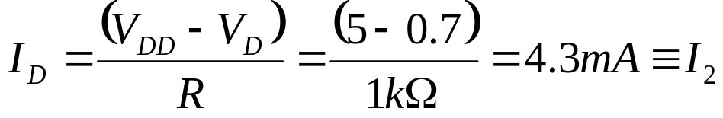
First iteration
Determine the current I_{D} and the diode voltage V_{D} for the circuit in Figure 5. With V = 5 V and R = 1 kΩ. Assume that the diode has a current of 1 mA at a voltage of 0.7 V, and that its voltage drop changes by 0.1 V for every decade change in current.
To begin the iteration we assume that V_{D} = 0.7 V and use the equation below to determine the current.
I₁= 1 mA , V₁ = 0.7 V
R
I
+
V_{DD}
-
V_{D}
We then use the diode equation shown below to obtain a better estimate for V_{D}
Substituting V₁ = 0.7 V, I₁ = 1 mA, and I₂ = 4.3 mA results in V₂ = 0.763. Thus the results of the first iteration are I_{D} = 4.3 mA and V_{D} = 0.763 V

Slide 29
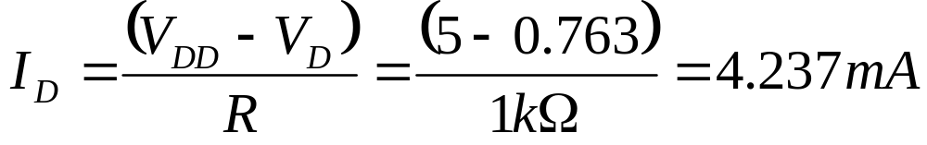
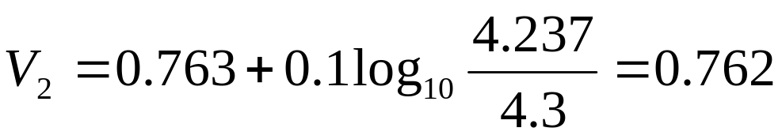
Second Iteration
R
I
Thus the results of the first iteration are I_{D} = 4.3 mA and V_{D} = 0.763 V. the second iteration proceeds in a similar manner: But this time I₁ = 4.3 mA and V₁ = 0.763 V.
+
V_{DD}
-
V_{D}
Thus, the second iteration yields I_{D} = 4.237 mA and V_{D} = 0.762V. Since these values are not much different from the values obtained after the first iteration, no further iterations are necessary, and the solution is I_{D} = 4.237 mA and V_{D} = 0.762V.

Slide 30
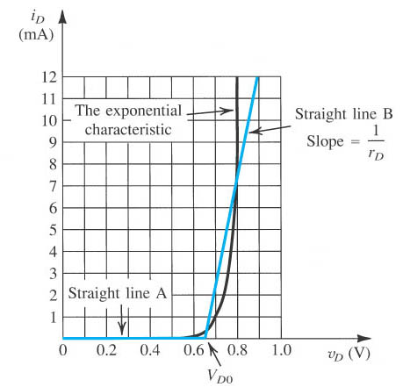
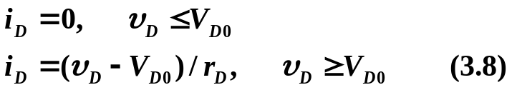
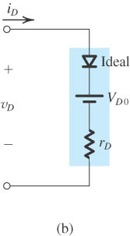
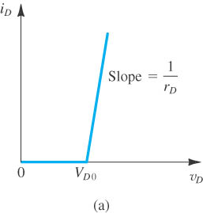
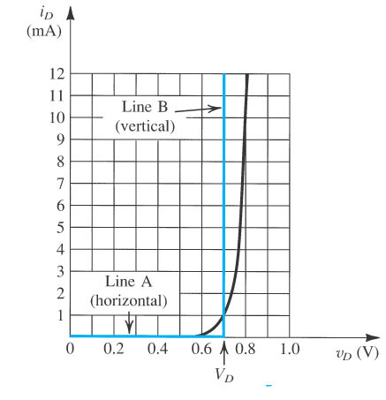
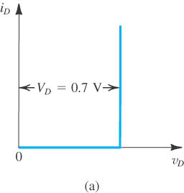
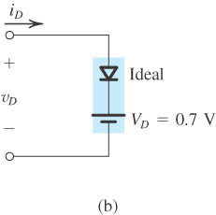

3.3.4 The need for Rapid Analysis
* In design process, rapid circuit analysis is necessary,
not in the final conformation process.
the piecewise-linear model.
* In the final conformation process, SPICE is the best choice.
3.3.5 The Piecewise-Linear model
the constant-voltage-drop model
3.3.6 The Constant-Voltage-Drop model
Microelectronic Circuits - Fifth Edition Sedra/Smith
Notes:
sedr42021_0312.jpg

Slide 31
Piecewise linear model
the piecewise-linear model.
Where V_{DO} is the intercept of line B on the voltage axis and r_{D} is the inverse of the slope of line B. For the particular example shown, V_{DO} = 0.65 V and r_{D} = 20 Ω.

Slide 32
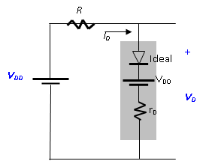
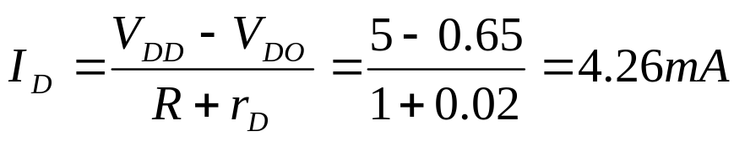
Example 2
Repeat the problem solved earlier with iterative analysis, utilizing the piecewise-linear model. (Take V_{DO} = 0.65 V and r_{D} = 20 Ω)
R
I
+
V_{DD}
-
V_{D}
Kirchoff loop equation for the equivalent circuit
The diode voltage can now be:

Slide 33
The Constant-Voltage-Drop Model
The constant-voltage-drop model of the diode forward characteristics and its equivalent-circuit representation.

Slide 34
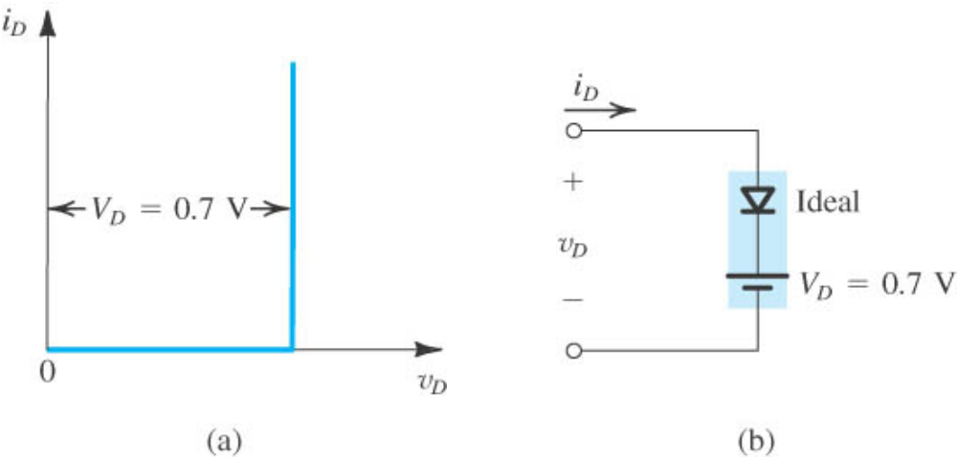
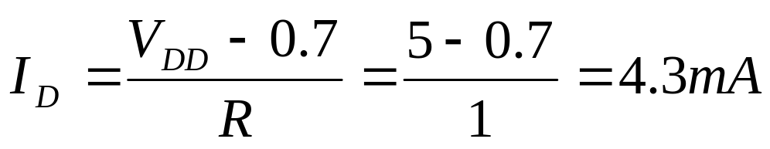
Example 3
Determine the current I_{D} and the diode voltage V_{D} for the circuit in Figure 5. With V = 5 V and R = 1 kΩ.
R
I
+
V_{DD}
-
V_{D}
Let’s solve the same problem using the constant-drop-voltage model.
We obtain;

Slide 35




Testing a diode

Slide 36





Types of diodes
Rectifier diodes
Designed to carry high current necessary in power supplies.
Signal diodes
Optimized for speed, they are used in low current and switching applications.
Zener diode
Designed to conduct in the reverse direction with a precise breakdown voltage, they are used in power supply regulation.

Slide 37


LEDs: Light-Emitting Diodes
Main difference is material is more exotic than silicon used in ordinary diodes/transistors
  typically 2-volt drop instead of 0.6 V drop
When electron flows through LED, loses energy by emitting a photon of light rather than vibrating lattice (heat)
LED efficiency is 30% (compare to incandescent bulb at 10%)
Must supply current-limiting resistor in series:
  figure on 2 V drop across LED; aim for 1–10 mA of current
Winter 2012
UCSD: Physics 121; 2012
Notes:
Electronics Overview
Lecture 8

Slide 38


The light-emitting diode (LED) is a semiconductor device that produces light when an electric current or voltage is applied to its terminals in the forward direction. – it is also classified as an optoelectronic device

Slide 39
1.5 The Application of Diode Circuits
Rectifier circuits
  Half-wave rectifier
  Full-wave rectifier
    Transformer with a center-tapped secondary winding
    Bridge rectifier
  The peak rectifier
Voltage regulator
Limiter

